Slide 1
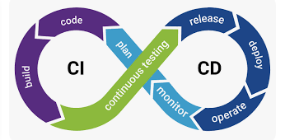
CI/CD: When technology takes your business to new horizons !
A presentation by : Alaa Magdy

Slide 2

CI: Continuous Integration
What is CI:
(CI) is a DevOps software development practice that enables the developers to merge their code changes in the central repository to run automated builds and tests
Benefits:
Improve Developer Productivity
Find and Address Bugs Quicker
Deliver Updates Faster
It’s basically all about code and how to deliver a code artifact

Slide 3
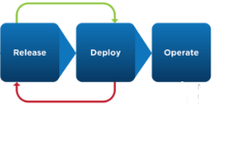
CD: Continuous Delivery
What is CD: Basically it’s the process where we have our product taken from the shelf and deployed automatically to the customer achieving continuous revenues.
In this phase we see our infra automatically
Provisioned, configured & deployed
Automated smoke tests of our product
As well.

Slide 4




Benefits of CI/CD
Protect Revenue:
It reduces the downtime due to a deployment crash or bug because we have automated smoke tests.
Avoid cost:
As we get less bugs in production hence we avoid the cost of fixing them.
Also it can detects security holes preventing embarrassing and costly situations saving our money and our face !
Also it provides automated infra deployment preventing human mistakes and saving time.
Reduce cost:
As it cleans up unused resources automatically saving us money
Increase Revenue:
More frequent deployments means more value hence, more revenue.
No Manual checks means faster TTM and more money !

